Slide 1

COMM 3590
Week 7
Unit 5:
Writing Effective Resumes
UNIT 6：
Writing Effective Cover Letters

Slide 2
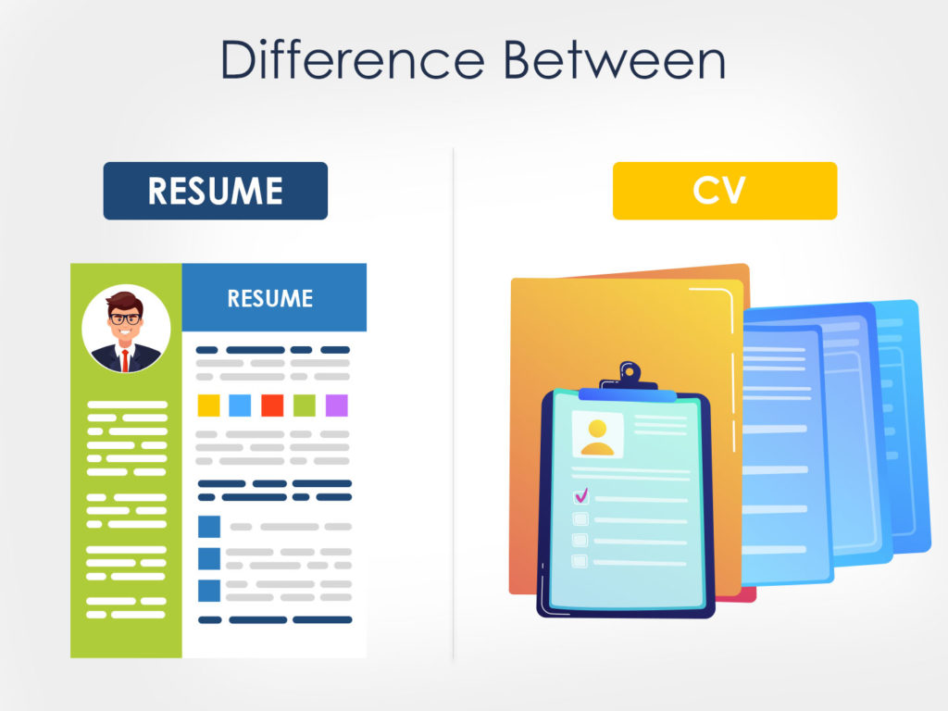

Slide 3
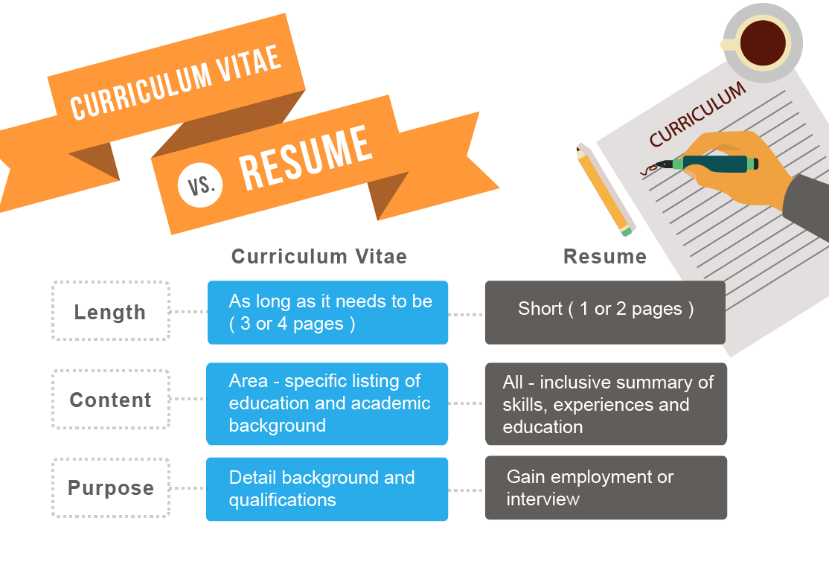
Resume and Curriculum Vitae (CV)

Slide 4
Resume
It's a marketing tool to get you an interview.
Summarizes your related background and helps to structure the interview.
Provides a sample of your organizational and communication skills.
Curriculum Vitae (CV)
“course of life”
Encyclopedia version of your professional life- work history, education, certifications, affiliations, publications, and specializations.
Typically limited to professions with standardized positions in which deep expertise is critical, such as academia, science, and medicine.
Europe & New Zealand | CV = Résumé
Australia & South Africa | CV & Résumé

Slide 5
Résumé
One-page description of your skills, education, and work experience.
Your unique brand in the job market.
Experience, education, training, certifications, skills, and traits
Work together with cover letter to highlight you
Customized for different job
Use of Sample/ Template?
Three parts:
Headings
Leads
Descriptions.

Slide 6
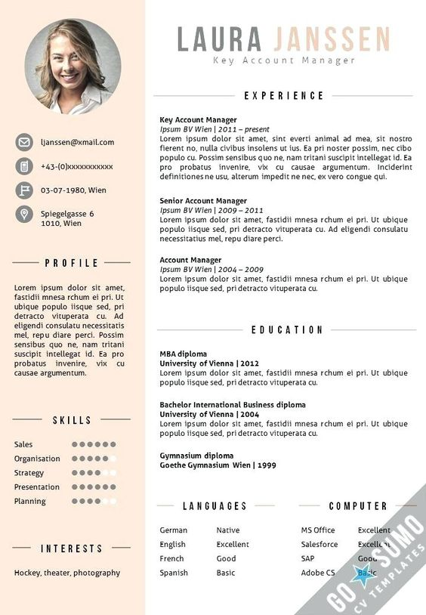
Headings
Category under which specific information is classified
Flags that signal individual areas of accomplishment.
Example:
“Education”
“Work Experience”
“Awards”
“Computer Skills”
“Language Abilities”
“Professional Memberships”
Bold/ highlight
concisely phrased and consistent
Name= first heading
Any information to avoid?
Source: etsy.com

Slide 7
Heading: Career Objective
A personal statement describe your career goal & the field you specialize in.
Pitch of your resume.
Not compulsory but a well-written objective can help you catch the attention of the recruiter.
Utilize your skills, achieve your career goals & contribute to the organization

Slide 8
Heading: Career Objective
Example 1:
Highly motivated individual and a certified digital marketer with strong SEO and SEM skills, attention to detail, and a solid online marketing background looking to obtain a position of SEO Specialist with XYZ company.
Example 2:
Looking for a challenging role in a reputable organization to utilize my technical, database, and management skills for the growth of the organization as well as to enhance my knowledge about new and emerging trends in the IT sector.
More examples available at:
https://www.naukri.com/blog/career-objective-for-freshers/?utm_content=naukriblog/#howtowriteanobjectiveforaresume

Slide 9
Leads
the first information on each new line under the heading
should include the most important information
Emphasize your INDIVIDUAL uniqueness
---------------- EDUCATION------------------
Bachelor of Business Administration
Wenzhou-Kean University
First Class Honour
3.8 GPA
Best Student of Year 2019
Source: etsy.com

Slide 10
Descriptions
information follows the lead
Use action words and specific quantification (when possible) to delineate your accomplishments, as well as why you were successful in the position.
Emphasize your accomplishment
Avoid general terms:
“Duties were”
“Responsibilities included”
Source: etsy.com

Slide 11
Example 1
Work Experiences
Example 2
Example 3
Yellowstone Natural Adventures. West Yellowstone, MT. Summers 2014–2015. Worked as a summer guide for white-water rafting trips in Yellowstone National Park. Duties included interacting with tourists, instructing them in proper safety guidelines and equipment use, giving presentations about the park, and overseeing proper campsite setup and breakdown.
Instructor/Leader. Yellowstone Natural Adventures, West Yellowstone, Montana. Served as a white-water guide for 8 extended trips each summer into Yellowstone National Park area. Instructed 15-20 participants on each trip in safety guidelines and proper use of marine and flotation equipment. Supervised 3 assistants to ensure that proper procedures were carried out in all areas of camping, rafting, and managing natural resources. Recognized by supervisors as outstanding with “Summer Employee of the Year” Award in both 2014 and 2015.
Instructor/Leader.
Yellowstone Natural Adventures, West Yellowstone, Montana.
White-water guide
Safety Instructor
Assistant supervisor
Summer Employee of the Year” Award
Adopted from: DiSanza & Legge, (2017)

Slide 12
WORDS AND PHRASES
Use active rather than passive words and phrases
Here is a short list of active words to give you some ideas:
Achieved Expanded Organized Administered
Implemented Planned Analyzed Improved
Presented Controlled Increased Promoted
Coordinated productivity Reduced Created
expenses Designed Initiated Researched
Developed Innovated Scheduled Diagnosed
Instructed Solved Directed Modified
Supervised Established Negotiated Trained

Slide 13

Résumé Basics
1. Length
most employers and recruiters read resumes in only 10 to 30 seconds.
keep your résumé short and concise.
2. Eliminate Errors
Try reading your résumé backwards
Higher chance to notice misspelled words
3. Use Action Words and Stress Accomplishments
Employers want to know what you can do
Highlight relevant skills

Slide 14
Dos and Don’ts
Relevant information
Action verbs to describe
Individualize
Write out words in full
Use numbers ( %, numbers)
Consistency
Specific
Irrelevant Information
Laundry List
Too generic / copy
Abbreviation
"I" statements when writing phrases

Slide 15
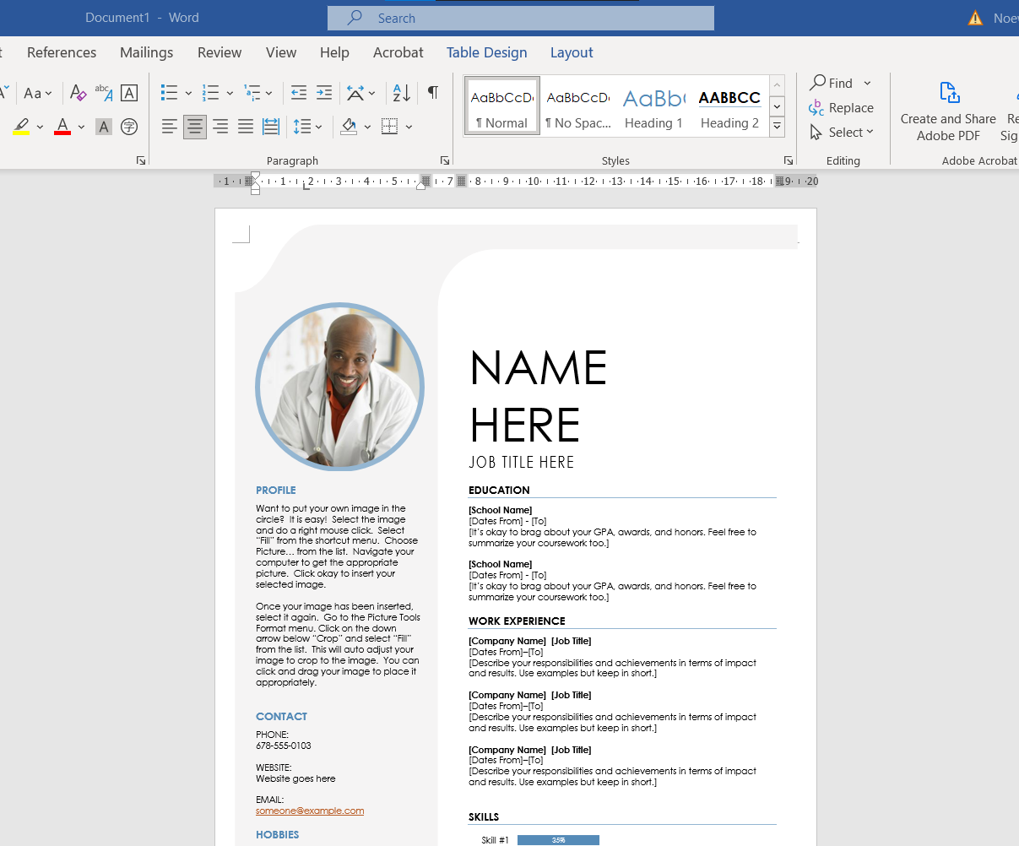
Microsoft Word

Slide 16
Useful Websites
1. https://www.resume.com/
Standard & Practical
2. https://www.canva.com/resumes/templates/
Designs & Colours
3. https://novoresume.com/resume-templates

Slide 17
Homework (DQ7)
Discussion Question
Points: | 15pts
Initial Post: | Thursday, 11.59pm
Responses: | Sunday, 11.59pm
Forum will no longer be available 48 hours after the deadline
Conduct research online to look for tips for resumé writing.
Identify 3 types of information that should not be included in a resumé.
Elaborate your answers.

Slide 18
HOMEWORK
Discussion Question
Points: | 50pts
Deadline: | 2 November 2021 (together with your AS8 Cover Letter)
Write a one-page Résumé to apply for the position in the previous job advertisement (in AS6).
Highlight your education and work history. Entries should be relevant, concise and clear.
Each work experience entry must begin with a verb and ordered in reverse chronology. When describing previous experience, use past tense; and when describing current experience, use present tense.
Be specific, and where possible, put a value to your achievements.
In the resume, you need to include your career objective and at least 2 working experiences.

Slide 19
References
Career Objective Or Resume Objective Samples.(2021). Retrieved from https://www.naukri.com/blog/career-objective-or-resume-objective-samples/
Résumé writing guide. (2019). Retrieved from https://www.jobscan.co/resume-writing-guide
DiSanza, J. R., & Legge, N. J. (2017). Business and Professional Communication: Plans, Processes, and Performance. Sixth Edition. Boston, MA: Pearson.
Doyle, A. (2019). What Is the difference between a résumé and a cover letter? Retrieved from https://www.thebalancecareers.com/ resume-vs-cover-letter-2060116
Farr, M. (2011). The quick resume and cover letter book (5th ed.). Indianapolis: JIST Publishing.
Résumé do‘s & don’ts. (2019). Retrieved from https://www.usf.edu/career-services/students/resume-dos-and- donts.aspx
Tomaszewski, M. (2021). CV vs Resume: The Key Differences to Choose Between the Two.
Retrieved from https://zety.com/blog/cv-vs-resume-difference?utm_source=google&utm_medium=sem&utm_campaign=13073552858&utm_term=cv%20and%20resume%20difference&network=g&device=c&adposition=&adgroupid=121729116706&placement=&gclid=Cj0KCQjw5JSLBhCxARIsAHgO2Sc6Nu8WpJw-EFz_xVM_u-g117AGOIQeLhoYMb8dGL4GPRKY7uTKosQaAj75EALw_wcB

